Slide 1
- Tryton installation & usage for first time administrators & users - Basic Functionality
Tryton By Example
Github - https://github.com/clixwise/tryton-by-example Version of presentation : 5.0 Version of Tryton : 5.8 Verified for execution on : Windows 10 & Powershell 7 Licence : CC BY 4.0 Author : Marc Rottiers

Slide 2
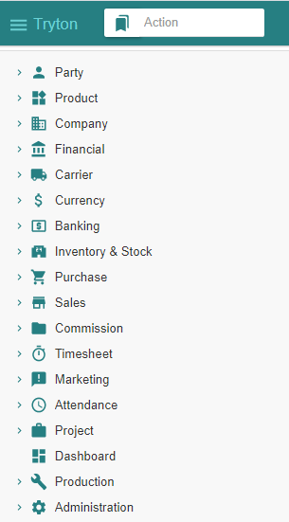
Table of Contents

Slide 3
TOC
Initial Configuration Wizard
Operations
Modules
Basic Configuration
Country & Currency
Party & Company & Employee
User
Accounting
Logins
Performing Initial Configuration : language, user, module
Explaining how to perform Operations
Explaining the concept of Modules
Basic Configuration
Installing Country & Currency
Installing Party & Company & Employee
Installing additional Users
Activating Financial modules
Demonstrate user privileges

Slide 4
Initial Configuration Wizard

Slide 5
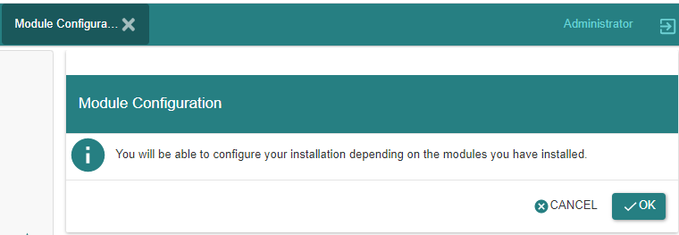
Configuration Wizard
This wizard allows :
To add languages,
To define new users and
To activate functional modules

Slide 6
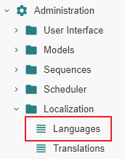
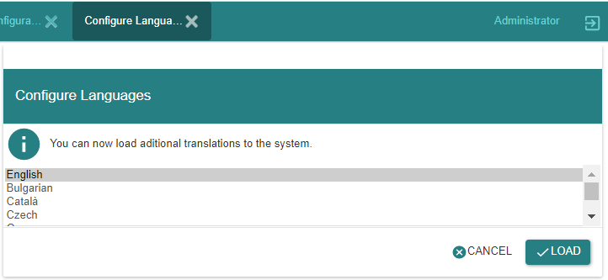
Adding « Languages »
This wizard allows to define new languages
If languages should be added later on, we can access the menu item « Languages »

Slide 7
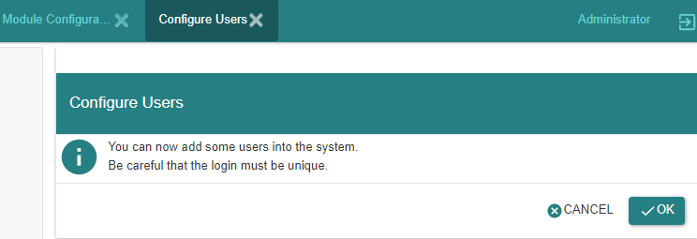
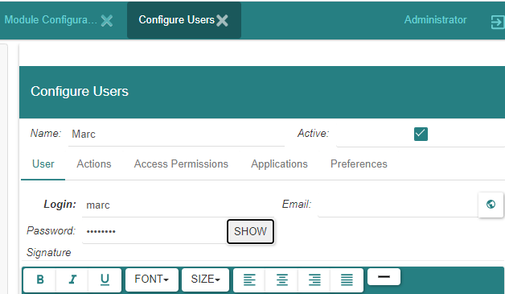
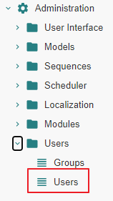
Defining « Users »
« User Administrator » is initially used to log into the system
It is then possible to define additional users
In this introductory documentation, we nevertheless perform most (if not all) operations with « User Administrator »
Additional users can be defined later : we access the menu item « Users »
Note that users cannot be deleted ; they can only be deactivated

Slide 8
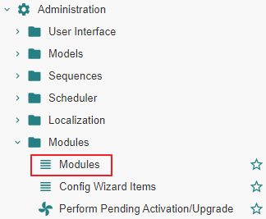
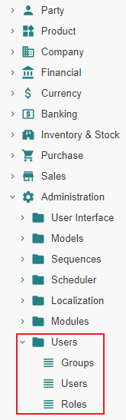
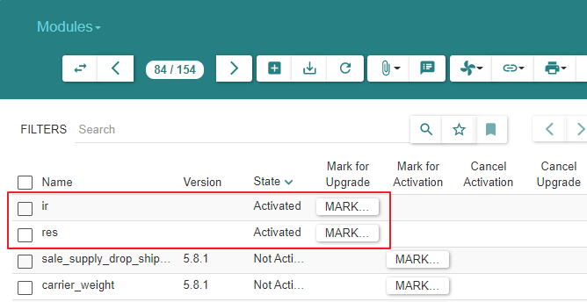
Activating « Modules »
Initially
Initially, all but two modules are activated : « ir » and « res »
We do not activate additional modules at this stage
User Administrator
Modules must be activated for this user to access functional subject areas s.a. « Party », « Sale », etc.
As we progress in our understanding of the system, we will activate modules progressively.
We do this by refering to the menu item « Modules ».
Other users
At the end of this document, we will show how to activate access to subject areas by other users.
We will do so thru Menu Tree Items « User Groups » or « User Roles ».

Slide 9
Re-executing wizards - Method 1
Wizard operations can be repeated later as well, using Menu items in the Tree on the left of the screen

Slide 10
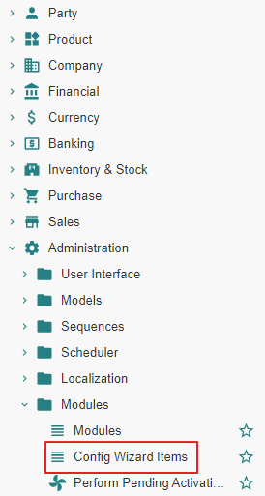
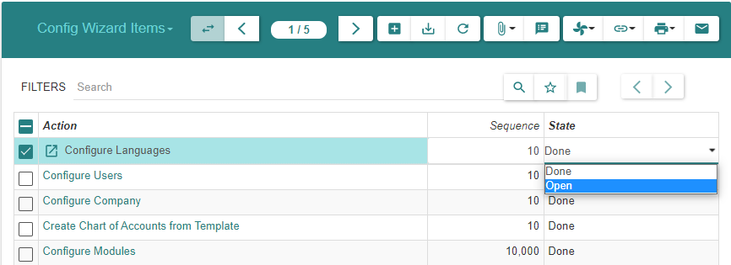
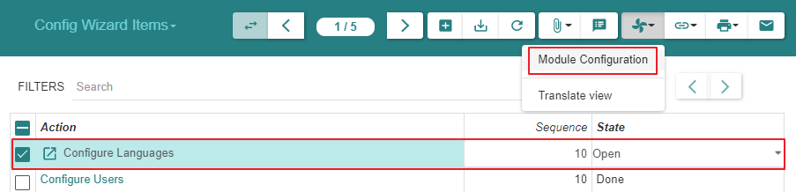
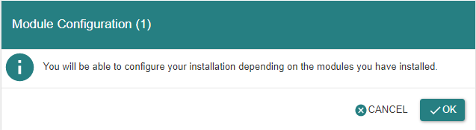
Re-executing wizards - Method 2
We need to reopen the wizard in order to execute it again

Slide 11
Operations

Slide 12
Motivation
Before exploring the functional aspects of the system, we explain the different widgets that support navigation in the system and trigger operations on items and item lists.
Please revisit this section whilst getting acquainted with the system subject areas.

Slide 13
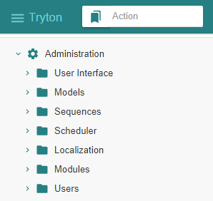
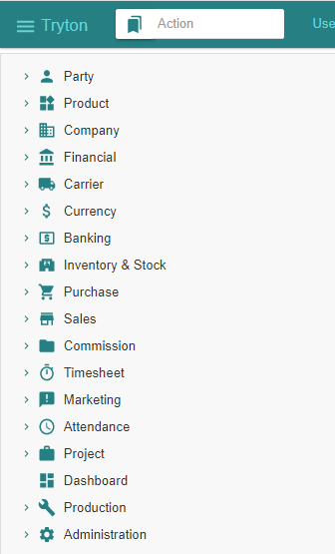
Application - Menu Tree - Triggering operations
The amplitude of the menu tree depends on which application modules have been activated (i.e. installed) for a given user. See next section.
Application modules belong to functional subject areas that are reflected in the Menu Tree : « Party », « Product », etc.
State of Menu Tree when
Initial modules activated
State of Menu Tree when
All modules activated

Slide 14
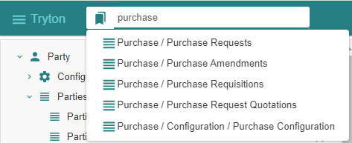
Application - Menu Tree - Search for menu item containing e.g. « Purchase »
A search mechanism exists for the tree of menu items
Here we assume that the « Purchase » modules have been activated and search for some related functionality

Slide 15
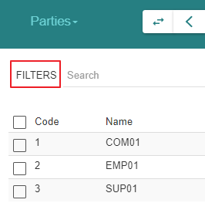
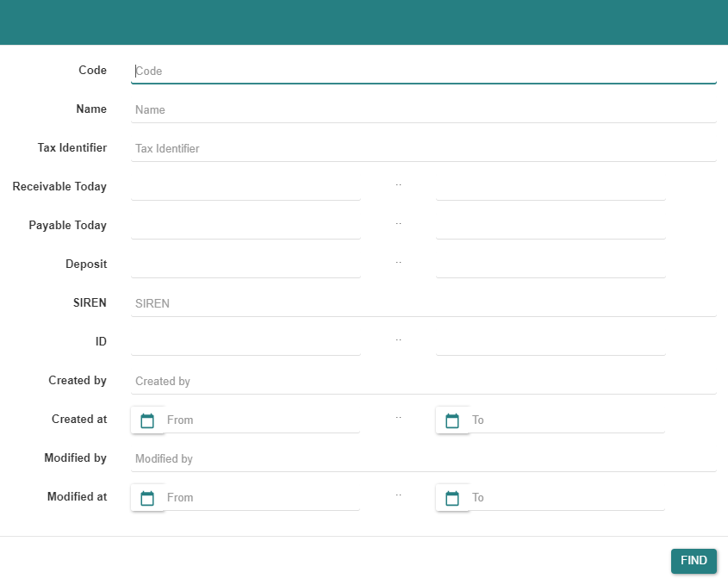
Entity - Filters
The proposed filter depends on the entity properties
Here an example for the entity « Party »

Slide 16
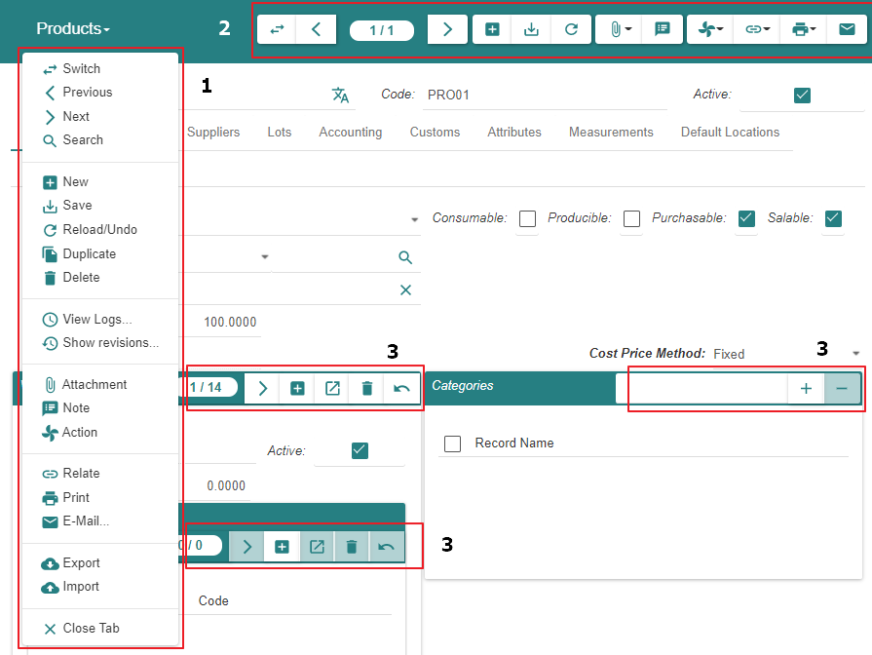
Entity - Menu Bars - An overview
Vertical menu bar displays all possible operations
Horizontal menu bar displays some entity or list operations
Horizontal menu bars display intra-entity operations

Slide 17
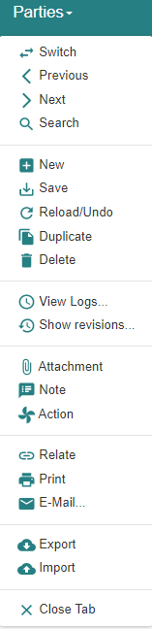
Entity - Menu Bars - Vertical Menu Bar
1
2
3
4
5
6
7
8
9
10
11
12
13
14
15
16
17
18
19
1 switch view from « item list » to « item »
2 « item » : previous in list
3 « item » : position in list
4 « item » : next in list
5 « item » : start adding
6 « item » : save
7 « item list » or « item » : reload / undo / refresh
8 « item » : duplicate
9 « item » : delete
10 « item list » : perform operation that is specific of this list
11
12 « item » : attach one or more documents (e.g. of type docx, xlsx, etc.)
13 « item » : attach a note
14 « item » : actions that are specific of the entity
15
16 « item » : print
17
18
19

Slide 18
Entity - Menu Bars - Horizontal Menu Bar
1 2 3 4 5 6 7 8 9 10 11 12 13
1 switch view from « item list » to « item » (*)
2 « individual record » : previous in list
3 « individual record » : position in list
4 « individual record » : next in list
5 « individual record » : start adding
6 « individual record » : save
7 « individual record » and « record list » : reload / undo / refresh
8
9
10 « record list » : perform operation that is specific of this list
11
12 « individual record » : print
13

Slide 19
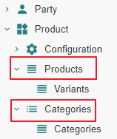
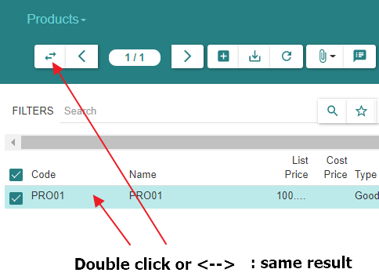
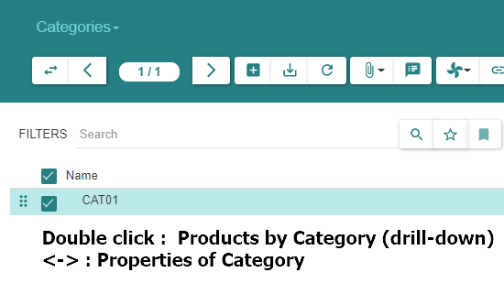
Entity - « Item Double-Click » vs « Menu Item Navigation »
When displaying a list of items, double-click on one of them mostly generates the same result as « <- -> ».
There are however exceptions whereby :
« <- -> » displays either nothing or details about the item itself.
« double-click » provides a « drill-down view » of objects belonging to the item
Examples
« Chart of Accounts » <- -> : displays nothing
« Chart of Accounts » double-click : displays the transactions for that account
« Product Category » <- -> : displays details about the category
« Product Category » double-click : displays the « Products » that belong to this « Category »

Slide 20
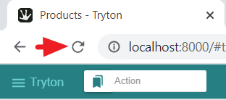
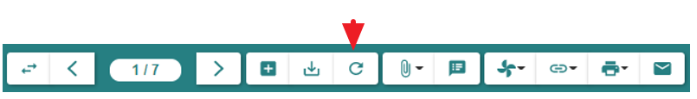
Application or Entity - Data Refresh Requirements
Sometimes it is necessary to refresh the screen using the « Browser Page Reload » button or the relevant menu item (see below).
This may happen e.g.
In the case of « Switching » from « Item » view to « List » view. For instance, when state information in a « Sales Order », e.g. « Draft », has been changed in the « Item » view it might incorrectly persist in the « List » view though it has evolved e.g. to « Confirmed ».
In the case of updating the « List of Product » sold by a « Supplier » then displaying the « Product » to show the « List of Suppliers »
In the case of adding a « Product Variant » in the « List of Variants », it is necessary to refresh the « Product » itself to take the variant into account on the screen

Slide 21
Modules

Slide 22
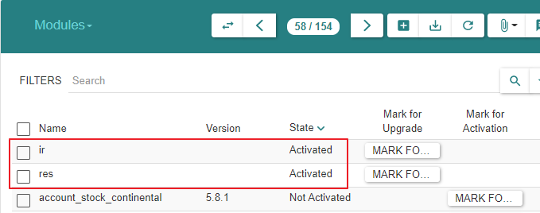
Motivation
The « Application » is implemented by « Modules » that use « Database Tables » and « Files » optionally. Modules are not explicitly grouped into functional subject areas.
Initially, all but two modules (« ir » & « res ») are inactivated : see below. The activation relies technically
Either on the usage of wizards and a mutual dependency mechanism.
Or based on their name by grouping them based on their prefix.
When modules are activated,
The database tables they use are created if required.
The menu items are added in the Tree on the left of the screen.

Slide 23
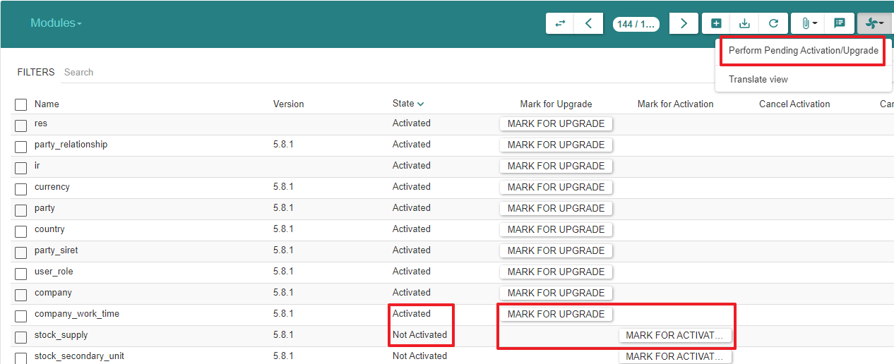
Modules
- Tryton optimizes operations by requiring activation of application modules.
- We will activate modules as we progress instead of activating all modules at once

Slide 24
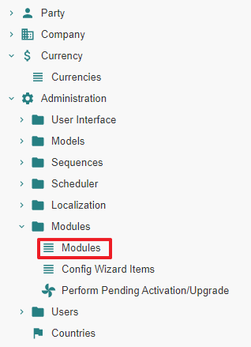
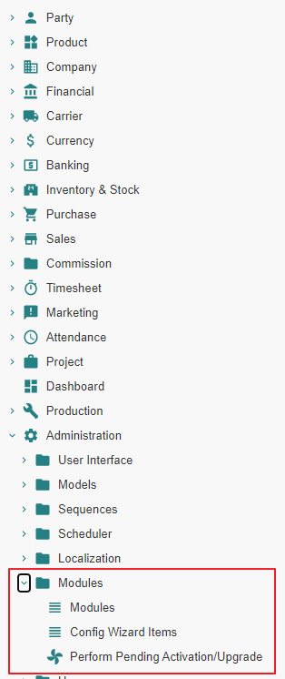
Modules
Growing list of menu items : initial & final list of menu items as modules are being installed

Slide 25
Modules
Entity | Module activation | User handling
Product | product-* | Creating product & variants
Party associated with Purchase | purchase-* | Creating supplier
Supplier Invoice
Supplier Shipment | stock-*
Purchase | purchase-* | Creating purchase order
Supplier Shipment |  | Creating supplier shipment
Supplier Invoice |  | Creating supplier invoice
Functional intent of module can be derived from its name

Slide 26
Basic Configuration

Slide 27
Motivation
Before examining the typical ERP transactions like « Sales », etc. we need to activate modules that support the different subject areas.
This link refers to official documentation about a « basic configuation » : https://tryton-administration-manual.readthedocs.io/en/latest/basic_config.html

Slide 28
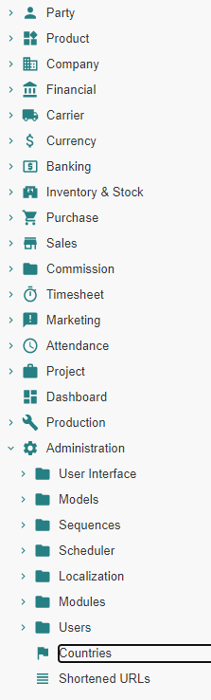
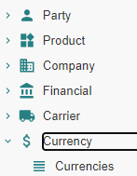
« Country » & « Currency »

Slide 29
Motivation
The TRYTON database and application contain minimal database tables and application modules. « Countries » and « Currencies » are extensively used. Hence, it is advised to :
Activate the corresponding application modules thereby also creating the required tables in the database.
Load the created tables with ISO normalised « Currency » and « Country » data
Finally, for each « Currency » of use in the « Company » operations, it is advised :
To set the « Rate » property to 1.0 for a « Reference Currency » ; f.i. « EUR rate » = 1.0
To set the « Rate » property to a relative value for each « Relative Currency » ; f.i. « USD rate » = 1.2
When the « Company » operates in a single currency environment, the « 1.0 » multiplication factor is used
When the « Company » operates in a multi-currency environment, each currency-related rate is used in addition as multiplication factor

Slide 30
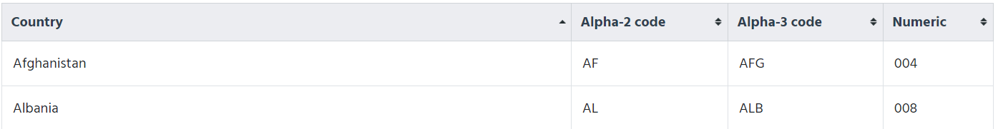
Documentation
https://docs.tryton.org/projects/modules-country/en/latest/

Slide 31
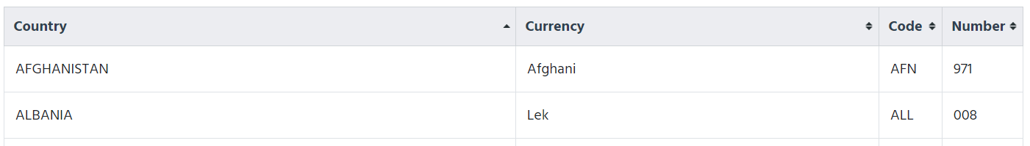
Documentation
https://docs.tryton.org/projects/modules-currency/en/latest/

Slide 32
Application - Activating the Modules

Slide 33
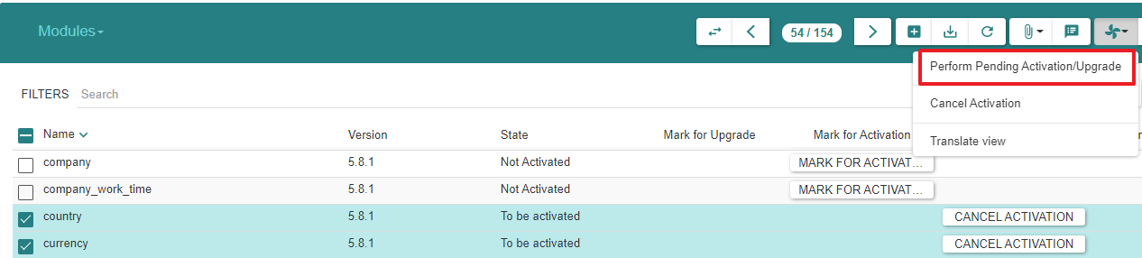
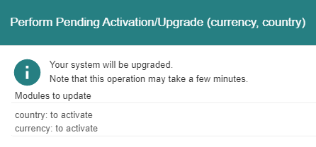
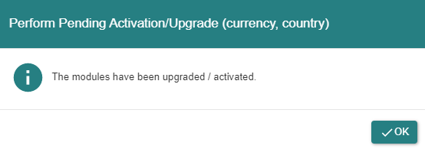
Mark « Country » & « Currency » For Activation then Execute

Slide 34
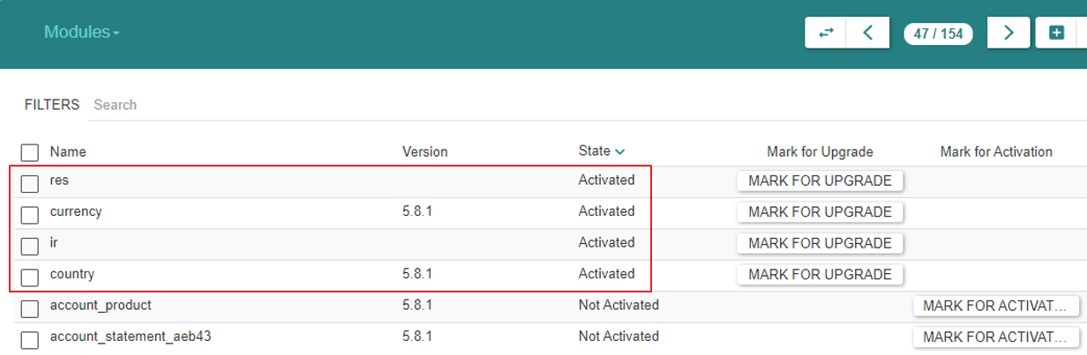
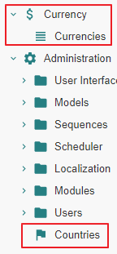
State « Post »
Note :
Use TRYTON « Reload » operation to refresh and display
« Countries » & « Currencies » appear in the Tree Menus
When clicking on « Countries or « Currencies », the data panel remains empty : we still need to load the database tables

Slide 35
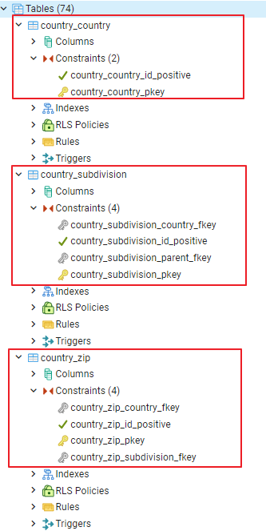
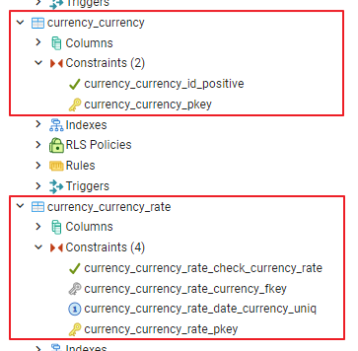
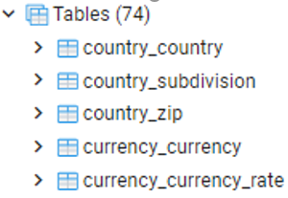
State « Post »
There are 3 additional « country » tables
There are 2 additional « currency » tables
All tables are still empty

Slide 36
Database – Loading the Tables

Slide 37
Documentation
[https://discuss.tryton.org/t/data-base-importing-countries-or-currencies/3811/7]
Special credits to David Harper

Slide 38
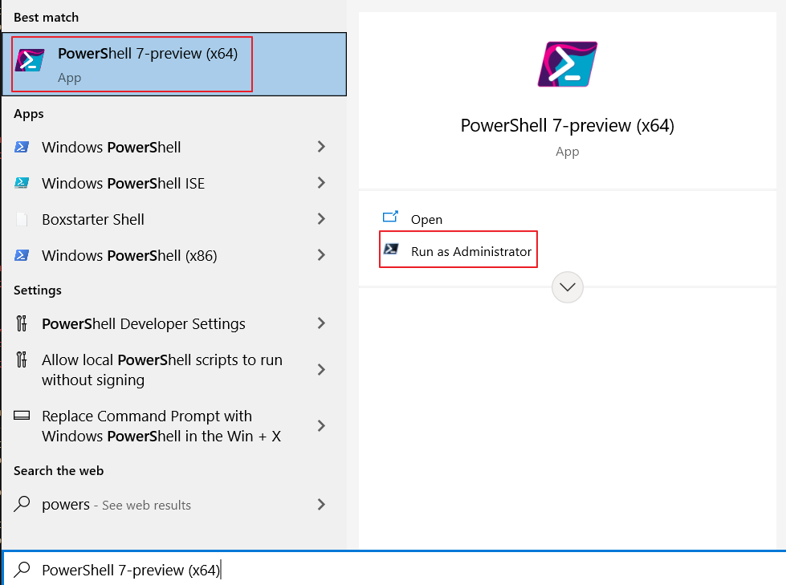
List of scripts related to some of the topics covered in this document
The « *.ps1 » files are Powershell scripts
Powershell can be accessed as indicated
The above scripts need some tuning with respect to the exact operation to be performed
The scripts are executed as e.g. : ./"Tryton 5.8 - Doc 05.01 - Basic functionality.import.tryt01.countries"
Load TRYTON tables “Countries” & “Currencies”
Tryton 5.8 - Doc 05.01 - Basic functionality.import.tryt01.countries | Fill tables with ISO countries
Tryton 5.8 - Doc 05.01 - Basic functionality.import.tryt01.currencies | Fill tables with ISO currencies

Slide 39
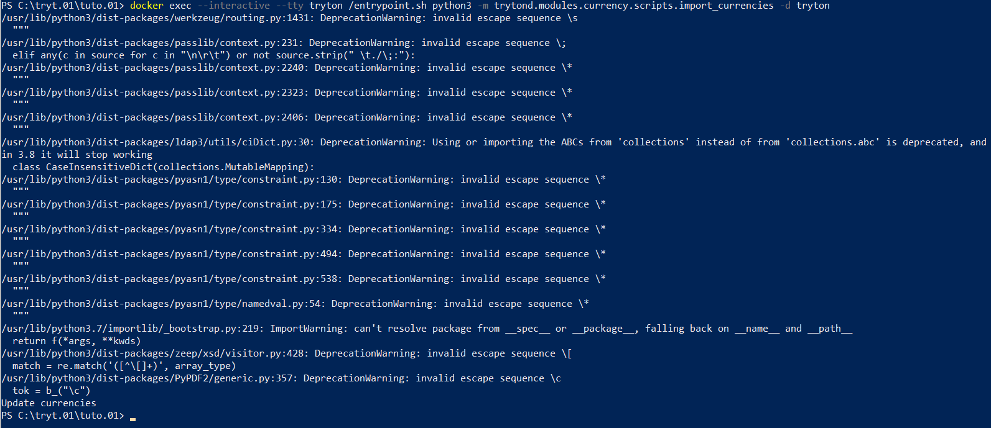
« Currency » - Load data
docker exec --interactive --tty tryton /entrypoint.sh python3 -m trytond.modules.currency.scripts.import_currencies -d tryton

Slide 40
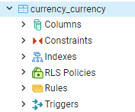
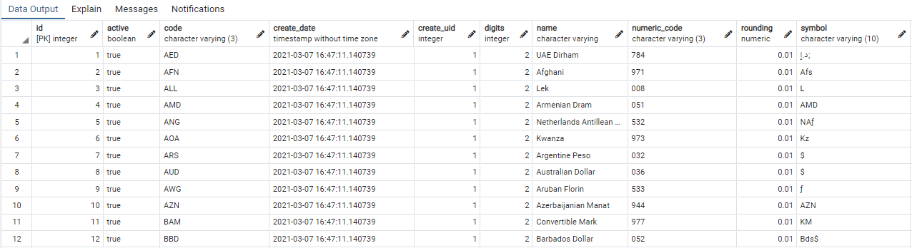
« Currency » - Load data

Slide 41
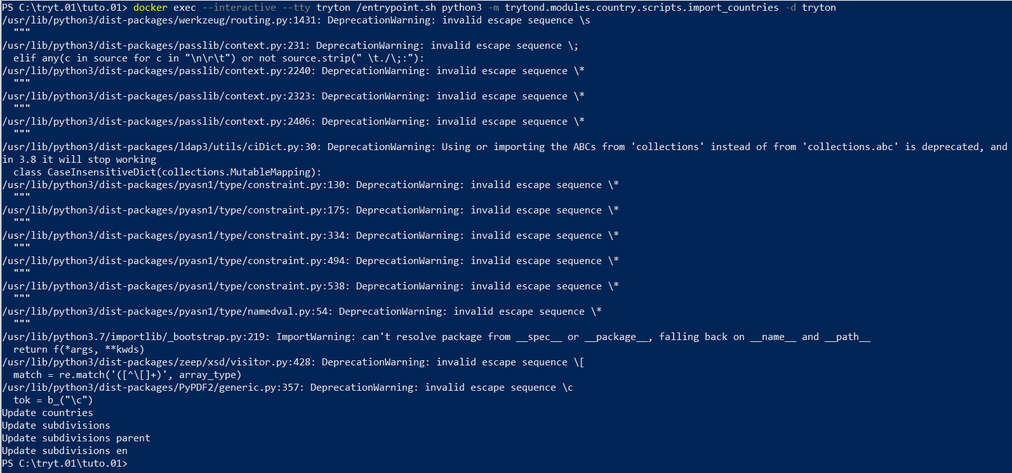
« Country » - Load data
docker exec --interactive --tty tryton /entrypoint.sh python3 -m trytond.modules.country.scripts.import_countries -d tryton

Slide 42
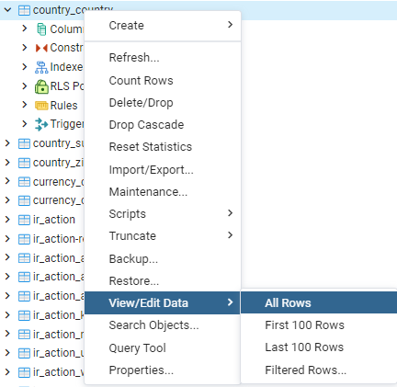
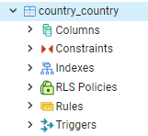
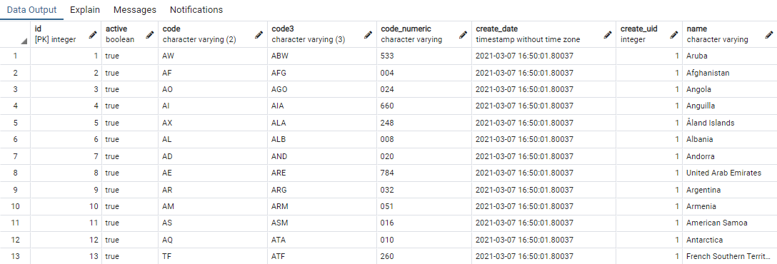
« Country » - Load data

Slide 43


State « Post »

Slide 44
Currency Rates

Slide 45

Motivation
Multi-currency operations are supported
In this is required, we need to define the rates for :
A « Reference Currency Rate » ; that rate will be 1.0
One or more « Relative Currency Rates » ; those rates will be relative to the reference rate.
Exemple :
Our reference currency is EUR : its rate is 1.0
One or our relative currencies is USD : ist rate is 1.2 (2021)
For each relative currency, we define as many dates as we want considering those dates are « Dates From » for the relative rate applicable from that moment onward.

Slide 46



Setting a « Reference Currency Rate » as of « Date from »
« EUR » is our « Reference Currency Rate ». Hence we set the rate at value 1.0

Slide 47



Setting « Relative Currency Rates » as of « Date from »
« USD » is used in our « Company »
So one of the « Relative Currency Rates » pertains to that « Currency ». Hence we set the rate at value 1.2 as of 2021-01-01 with respect to the « EUR »
We can define additional « Relative Currency Rates »
For other currencies
For other « Date from » values

Slide 48
« Party » & « Company » & « Employee »

Slide 49
Motivation
We activate modules and create database content related to the following entities :
« Party » : an entity that represents some ERP-relevant actor
« Company » : a specialized « Party » entity
« Employee » : a specialized « Party » entity
« Parties associated to Sales » : a « Party » role (activated and installed later)
« Parties associated to Purchases » : a « Party » role (activated and installed later)
Party associated to Sales
Party
Party associated to Purchases
Company
Employee
Entity
Entity
Entity Role
Entity Role

Slide 50


Motivation
« User » vs. « Party »
A « User » is a user of the system with login and password.
A « User » is not a « Party ».
A « User » is not necessarily an « Employee » of the « Company ». F.i. he/she can be a consultant.
The default user is « admin ».
The content of the « res_user » database table with « User » entities
The content of the « party_party » database table with « Company », « Employee » and « Supplier » (installed later) entities

Slide 51
« Party »

Slide 52
Motivation
A « Party » is an abstract entity that stands for the common properties of a speciliazed concrete entity such as « Company », « Employee », « Party associated to Purchase », etc.
We activate the modules that relate to « Party ». Subsequently, we define concrete parties :
The first approach for defining a specialized entity is :
First define a « Party » with the idea that it will be referenced by a specialized entity.
Subsequently define the specialized entity (e.g. a « Company ») with reference to its generic « Party » parent.
The second approach for defining a specialized entity is :
Define the specialized entity like « Company »
Doing so, the system lets you create the generic « Party » entity on the fly

Slide 53
Module Activation

Slide 54
Documentation
[https://docs.tryton.org/en/latest/party.html#index-party]

Slide 55




Modules - Activation
We ensure that all « Party » modules are activated

Slide 56


Status Post - Menu Tree Items « Party »
Menu Tree Items « Party »

Slide 57



Status Post - Menu Tree Item « Sequence »

Slide 58


Database tables created

Slide 59
Creation of Parties

Slide 60

« Party », « Company » & « Employee »
A « Party » is an abstract entity.
Its concrete subentities are of type « Company », « Employee », etc.
We can define the corresponding abstract and concrete entities in two ways :
Method 1 :
We define a « Party » « X » or « Y » by clicking on « Parties », and fill their properties conformant those inherited by the concrete entity
Subsequently, we define :
The « Company » « X » by referencing its corresponding « Party » « X »
The « Employee » « Y » by referencing its corresponding « Party » « Y »
Method 2 :
We define a « Party » « X » or « Y » by clicking on « Parties », and fill their properties conformant those inherited by the concrete entity
We define the « Company » « X » by clicking on « Companies » and in doing so we create « Party » « X » in the process
We define the « Employee » « Y » by clicking on «Employees » and in doing so we create « Party » « Y » in the process
We will use Method 1 for defining a « Company » COM01
We will use Method 2 for defining an « Employee » EMP01

Slide 61
« Company »

Slide 62



Modules - Activation
We ensure that all « Company » modules are activated

Slide 63

Modules - Activation - Summary State

Slide 64

Modules - Activation
Activating the « Company » modules creates the Menu Tree Items for « Company » as well as « Employee »
When an indented Menu Tree Item construction exists, it means that e.g. « Companies » can be displayed as a tree of « Companies » as well as a list.
The top level « Company » menu will display the « Companies » in a tree manner.
The bottom level « Company » will display the « Companies » in a list manner.

Slide 65


Create « Company » COM01
Step 1
Create the « Party » COM01
Step 2 Create the concrete « Company » entity COM01 that references the abstract « Party » entity COM01

Slide 66
« Employee »

Slide 67
Modules - Activation
By activating the « Company » modules, both the « Company » and « Employee » parties are made available
There are no « Employee » modules to activate

Slide 68



Creating « Employee » EMP01
We create « Employee » EMP01
In the process,
We create its corresponding « Party » EMP01
We reference the existing « Company » COM01

Slide 69


Creating « Employee » EMP01
The « Employee » appears now
In the list of employees
In the list of employees for « Company » COM01

Slide 70
Final State

Slide 71



« Party », « Company », « Employee »
Note : this is one of these cases where you need to refresh the browser in order to appropriately display the parties that were just defined.

Slide 72
« User »

Slide 73

Definitions : « User » and « Employee »
An « Employee » is a « Party », a « User » is not
A « Company » aggregates « Employees », not « Users »
A « User » references a « Current Company », a « Main Company » and an « Employee »
A « User » is someone who logs into the system with his/her user id and password
Thanks to the « User » - « Company » link, the user has the permission to install and display relevant company records
We will use this relationship to create a Chart of Accounts for « Company » COM01

Slide 74
Definitions : « User » and « Employee »
Party associated to Sales
Party
Party associated to Purchases
Company
Employee
Entity
Entity
Entity Role
User
Entity Role

Slide 75
Application - Activating Modules

Slide 76


Activating module « User_role »

Slide 77
« User » Administrator

Slide 78



User « Administrator »
« User Administrator» is installed by default
We add a reference to « Company COM01 » and « Employee EMP01 »

Slide 79
« User » Marc & Paula

Slide 80
Motivation
A « User » is a user of the system with a login and a password.
The default user is « admin ». I use the password « Password ».
We install additional users « Marc » & « Paula » without special privileges
And briefly login then logout to see what is permitted
From now on, all operations are performed in this basic introduction with « User » « Administrator »

Slide 81


« User Administrator » installs « User Marc »
User « Marc » is installed with reference to « Company COM01 »
When loging in with « User Marc », we observe that the menu tree is reduced.

Slide 82

« User Administrator » installs « User Paula »
User « Paula » is installed without references to « Company COM01 » and « Employee EMP01 »
When loging in with « User Paula », we observe that the menu tree is reduced.

Slide 83
« User » Gustave

Slide 84



« User Administtrator » creates then deactivates « User Gustave »
User « Gustave » is installed then deactivated
This demonstrates that a user cannot be deleted

Slide 85
State Post

Slide 86

State « Post » - Users

Slide 87




State « Post » - User « Admin »

Slide 88



State « Post » - User « Paula », « Marc »

Slide 89





State « Post » - Database

Slide 90
« Financials » « Chart of Accounts » & « Fiscal Year and Period » & « Journal »

Slide 91
Documentation
[https://tryton-administration-manual.readthedocs.io/en/latest/basic_config.html#installing-a-chart-of-accounts]
[https://tryton-administration-manual.readthedocs.io/en/latest/accounts.html]

Slide 92
Precondition
Before activating the Financial Modules, it is advised to properly configure the « Administrator » user
The user should reference :
The « Current Company » field with e.g. « COM01 » i.e. the company for which the « Chart of Accounts » will be created.
An « Employee » field with e.g. « EMP01 » who is part of « Company COM01 »
Under those conditions, at the end of module activation, a « Create Chart of Accounts » wizard will be able to reference « COM01 » and create the chart of accounts appropriately.

Slide 93

Error conditions
If « User Administrator » activates financial modules without referencing « Company COM01 », the creation of the « Chart of Accounts » will have to be aborted. Should this be the case, we will show how to recover from this situation and, more generally, show how to execute once again a previously aborted wizard.
If « User Administrator » activates financial modules without referencing « Employee EMP01 », the Menu Tree Item « Financial » is not created in the left pane. We have not found a way to recover from this error situation besides restoring the database in a state « before »

Slide 94
Activating Modules

Slide 95

Documentation

Slide 96

Documentation

Slide 97





Documentation

Slide 98




State Post
Notice :
The « Create Chart of Accounts from Template » wizard Item is « done »
The « Company COM01 » has no « Accounting » Tab
There are additional Menu Items in the Menu Tree

Slide 99



Situation finale

Slide 100



Situation finale

Slide 101

Situation finale

Slide 102
Error Case

Slide 103




Error case - « User Administration » is not linked to « Company COM01 »

Slide 104



How to recover
A announced in the « Precondition », we set the link to our company « COM01 »
We modify the wizard state from « done » to « open »

Slide 105


How to recover - method 1

Slide 106




How to recover - method 2

Slide 107

Error case - « User Administration » is not linked to « Employee EMP01 »
The Menu Tree Item « Financial » is not created
There is apparently no way to recover except to restore the database in a prior state and to update the « User Administrator » with the appropriate « Company COM01 » and « Employee EMP01 » links

Slide 108


Financial - Fiscal Years & Periods

Slide 109
Documentation
Accounts :
[https://tryton-administration-manual.readthedocs.io/en/latest/accounts.html] Post Move Sequence : [https://groups.google.com/g/tryton/c/a4fobeaYn48]
Opening a Fiscal Year : [https://discuss.tryton.org/t/how-to-create-a-fiscalyear/2380]

Slide 110


Slide 111


Slide 112





Slide 113



Create Periods

Slide 114




Slide 115

Financial - Chart of Accounts

Slide 116


Execute

Slide 117


Account configuration

Slide 118
Financial - Journals

Slide 119



Journals

Slide 120


Journals

Slide 121


Party

Slide 122


How to recover

Slide 123

Database

Slide 124


Account Type Templates (1/2)

Slide 125


Account Type Templates (2/2)
Templates are used to generate the actual « Chart of Account ». As such, there is no reference to a « Company »

Slide 126


Account Types (1/2)
The « Account Type » contains a reference to the « Company ». This contrasts with the « Account Type Template » which does not

Slide 127


Account Types (2/2)

Slide 128



Account Templates (1/3)

Slide 129


Account Templates (2/3)

Slide 130

Account Templates (3/3) - Note

Slide 131



Accounts (1/2)

Slide 132


Accounts (2/2)

Slide 133



Problem with closed accounts
[https://discuss.tryton.org/t/value-for-field-account-is-not-valid/3106/9]
Select * from account_account where closed = true;
UPDATE account_account SET closed = false WHERE closed = true;

Slide 134
Logins

Slide 135

Motivation
We experiment in changing user authorizations with respect to accessing subject areas in the application
The « User Administrator » can tailor this by exercising « User Groups » and « User Roles »

Slide 136
User Capabilities - Ante

Slide 137



State - User Capabilities

Slide 138
User Groups - Modify

Slide 139


List of « User Groups »
Linking the « User » and the « Group » is possible in two ways :
Method 1 : displaying the choosen group then linking the user to it
Method 2 : displaying the choosen user then linking the group to it

Slide 140



Attach « User Marc » to a « User Group » - Method 1

Slide 141

Attach a « User Group » to « User Marc » - Method 2

Slide 142
User Roles - Modify

Slide 143



« User Roles »
We define a « Role » that aggregates two « Groups »

Slide 144

Attach « User Paula » to a « User Role » 1/2
Once a « Role » is defined, it can be referenced by a « User »
Attaching a « Role » allows also to restrain the « from » and « to » dates

Slide 145

Attach « User Paula » to a « User Role » 2/2
We must remember that « User Paula » has no reference so far to « Company COM01 »
In order to obtain the intended result for « User Paula », i.e. displaying the « Country » and « Currency » Menu Tree Items, we must add that reference.

Slide 146
User Capabilities - Post

Slide 147


State - User Capabilities
« User Marc »
« User Paula »

